Slide 1
Optimizing Heart Disease Prediction Using Machine Learning
By: Emma Mukuri Maka

Slide 2

Introduction
Context: Heart disease is a leading cause of mortality worldwide. Accurate prediction models are crucial for early diagnosis and treatment.
Problem Statement: How can we optimize the prediction accuracy of heart disease presence using machine learning algorithms?

Slide 3

Dataset Overview
Source: UCI Heart Disease dataset
Description: The dataset contains 303 instances with 14 attributes including age, sex, chest pain type, resting blood pressure, cholesterol levels, etc.

Slide 4
Data Wrangling
Steps:
Handling missing values
Encoding categorical variables
Normalizing numerical features
Splitting data into training and testing sets

Slide 5
Exploratory Data Analysis (EDA)
Visualizations:
Distribution of target variable (presence of heart disease)
Correlation heatmap of features
Box plots of numerical features by target variable

Slide 6
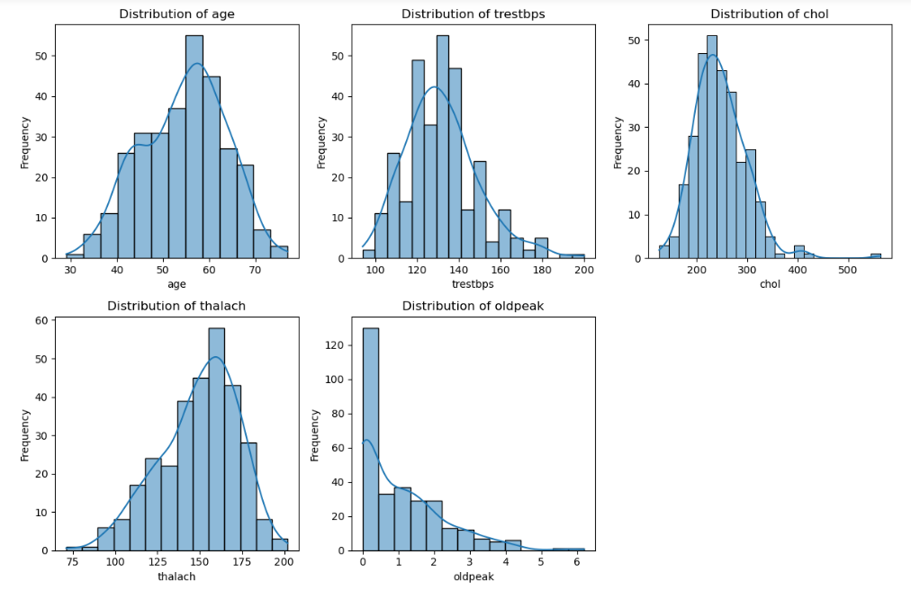
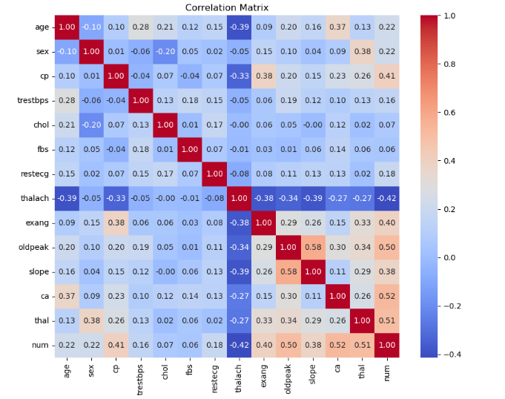
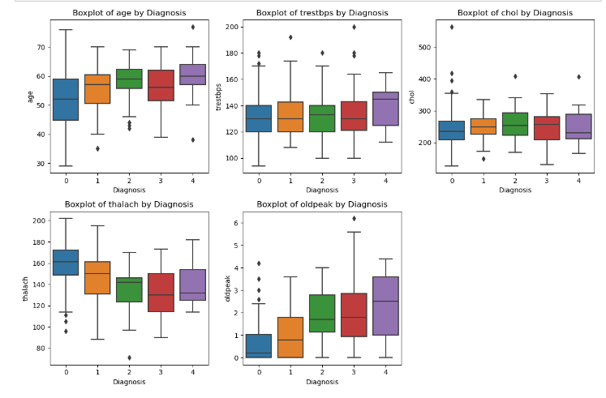

Slide 7
Machine Learning Models
Models Evaluated:
Gradient Boosting Classifier
Random Forest Classifier
K-Nearest Neighbors (KNN)

Slide 8
Model Evaluation Metrics
Metrics Used:
Accuracy Score
Confusion Matrix
Receiver Operating Characteristic (ROC) Curve
Area Under the Curve (AUC)

Slide 9
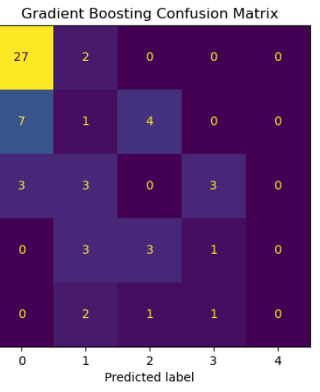
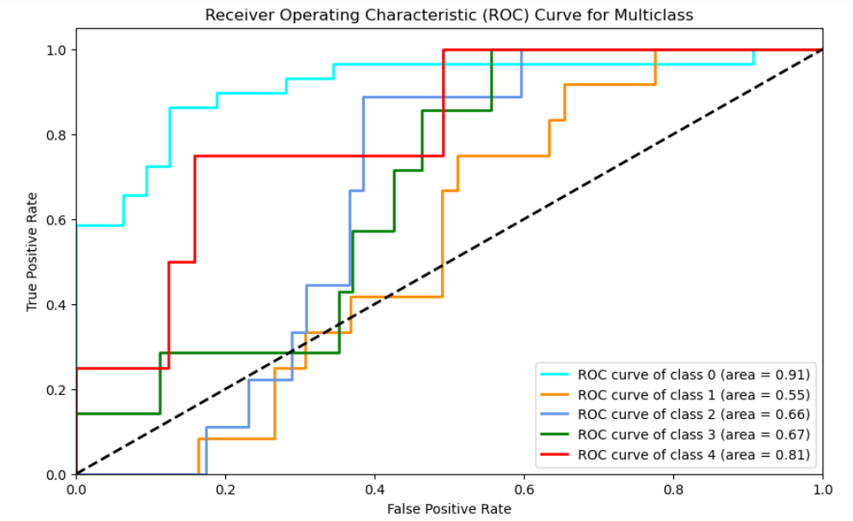
Gradient Boosting Classifier Results
Accuracy: 47.55%
AUC Values: Class 0: 0.91, Class 1: 0.55, Class 2: 0.66, Class 3: 0.67, Class 4: 0.81

Slide 10
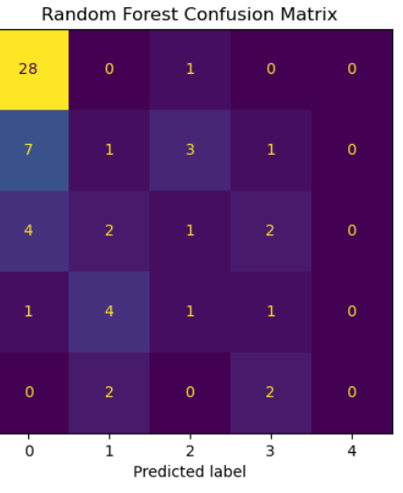
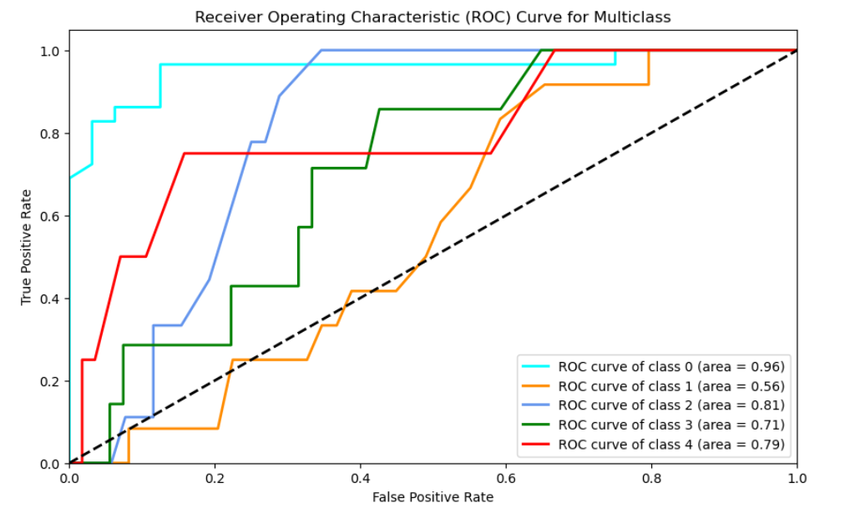
Random Forest Classifier Results
Accuracy: 50.20%
AUC Values: Class 0: 0.96, Class 1: 0.56, Class 2: 0.81, Class 3: 0.71, Class 4: 0.79

Slide 11
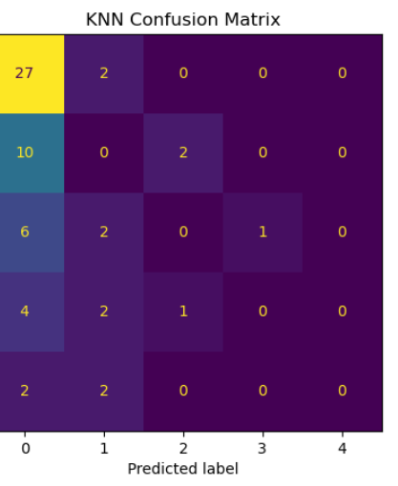
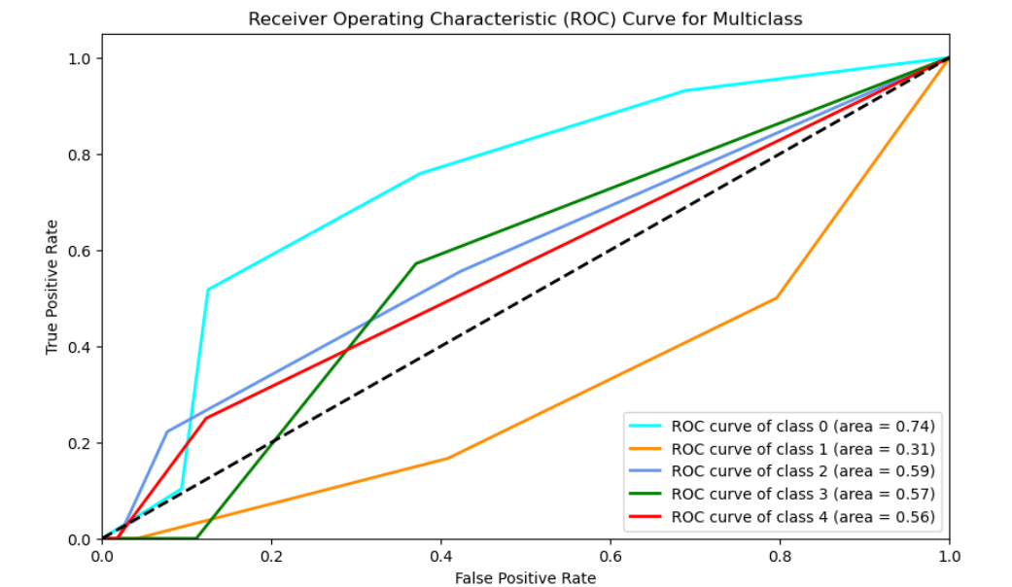
K-Nearest Neighbors (KNN) Results
Accuracy: 44.62%
AUC Values: Class 0: 0.74, Class 1: 0.31, Class 2: 0.59, Class 3: 0.57, Class 4: 0.56

Slide 12
Comparative Analysis
Accuracy Comparison: Random Forest > Gradient Boosting > KNN
Confusion Matrix Insights: Random Forest shows fewer misclassifications across all classes.
ROC and AUC Insights: Random Forest has the highest AUC values across most classes.

Slide 13
Conclusion
Best Model: Random Forest Classifier
Key Findings:
Highest accuracy (50.20%)
Best performance in handling multiclass predictions
Robust against overfitting due to averaging multiple decision trees

Slide 14
Future Work
Hyperparameter tuning for further optimization
Integration of additional feature selection techniques
Exploration of other machine learning models like Support Vector Machines (SVM) or Neural Networks

Slide 15
Questions?

